Slide 1
Virtualization

Slide 2
Virtualization
Virtualization is a group of technologies and concepts that are meant to provide an abstract environment—whether virtual hardware or an operating system—to run applications.
Virtualization assign's a logical name for a physical resource.
Then provides a pointer to that physical resource when a request is made.
Virtualization is dynamic in that the mapping can be assigned based on rapidly changing conditions.

Slide 3
Virtualization
Virtualization is a major design technique for all cloud architectures.
In cloud computing it refers primarily to platform virtualization, or the abstraction of physical IT resources from the people and applications using them.
Virtualization allows servers, storage devices, and other hardware to be treated as a pool of resources rather than discrete systems, so that these resources can be allocated on demand.

Slide 4
Virtualization Benefits
Increased performance and computing capacity -
The average end-user desktop PC is powerful enough to meet almost all the needs of everyday computing.
Almost all these PCs have resources enough to host a virtual machine manager and execute a virtual machine with by far acceptable performance.
The same consideration applies to the high-end side of the PC market, where high end servers can provide immense compute power that can accommodate the execution of hundreds or thousands of virtual machines.

Slide 5
Virtualization Benefits
Underutilized hardware and software resources -
Computers today are so powerful that in most cases only a fraction of their capacity is used by an application or the system. Moreover, if we consider the IT infrastructure of an enterprise, many computers are only partially utilized.
Using these resources for other purposes could improve the efficiency of the IT infrastructure.
To transparently provide such a service, it would be necessary to deploy a completely separate environment, which can be achieved through virtualization.

Slide 6
Virtualization Benefits
Lack of space -
The continuous need for additional capacity, whether storage or compute power, makes data centers grow quickly.
In most cases enterprises cannot afford to build another data center to accommodate additional resource capacity.
This condition, along with hardware underutilization, has led to the diffusion of a technique called server consolidation, for which virtualization technologies are fundamental.

Slide 7
Virtualization Benefits
Greening initiatives -
Recently, companies are increasingly looking for ways to reduce the amount of energy they consume and to reduce their carbon footprint.
Data centers are one of the major power consumers; they contribute consistently.
Maintaining a data center operation not only involves keeping servers on, but a great deal of energy is also consumed in keeping them cool.
Infrastructures for cooling have a significant impact on the carbon footprint of a data center.
Hence, reducing the number of servers through server consolidation will definitely reduce the impact of cooling and power consumption of a data center.
Virtualization technologies can provide an efficient way of consolidating servers.

Slide 8
Virtualization Benefits
Rise of administrative costs -
Power consumption and cooling costs have now become higher than the cost of IT equipment.
Moreover, the increased demand for additional capacity, which translates into more servers in a data center, is also responsible for a significant increment in administrative costs.
Common system administration tasks include hardware monitoring, defective hardware replacement, server setup and updates, server resources monitoring, and backups.
Virtualization can help reduce the number of required servers for a given workload, thus reducing the cost of the administrative personnel.

Slide 9
Virtualization
Virtualization is a broad concept that refers to the creation of a virtual version of something, whether hardware, a software environment, storage, or a network.
In a virtualized environment there are three major components: guest, host, and virtualization layer.
The guest represents the system component that interacts with the virtualization layer.
The host represents the original environment where the guest is supposed to be managed.
The virtualization layer is responsible for recreating the same or a different environment where the guest will operate

Slide 10
Virtualization
In the case of hardware virtualization, the guest is represented by a system image comprising an operating system and installed applications.
These are installed on top of virtual hardware that is controlled and managed by the virtualization layer, also called the virtual machine manager.
The host is instead represented by the physical hardware, and in some cases the operating system, that defines the environment where the virtual machine manager is running.

Slide 11
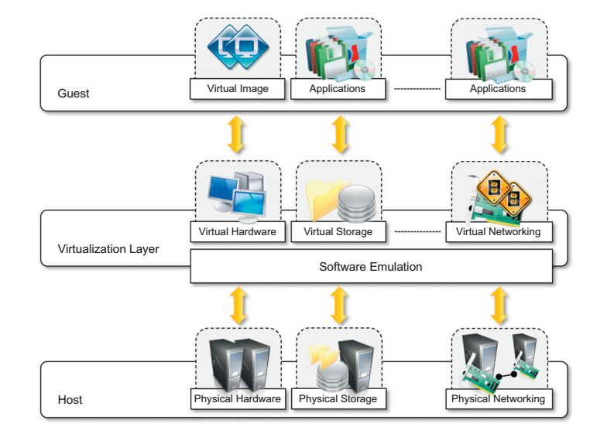
Virtualization

Slide 12
Virtualization
The main common characteristic of this implementations is the fact that the virtual environment is created by means of a software program.
The ability to use software to emulate such a wide variety of environments creates a lot of opportunities, previously less attractive because of excessive overhead introduced by the virtualization layer.
The technologies of today allow profitable use of virtualization and make it possible to fully exploit the advantages that come with it.
Such advantages have always been characteristics of virtualized solutions.

Slide 13
Virtualization - Security
The ability to control the execution of a guest in a completely transparent manner provides new possibilities for delivering a secure, controlled execution environment.
The virtual machine represents an emulated environment in which the guest is executed.
All the operations of the guest are generally performed against the virtual machine, which then translates and applies them to the host.
This level of indirection allows the virtual machine manager to control and filter the activity of the guest, thus preventing some harmful operations from being performed.

Slide 14
Virtualization - Security
Resources exposed by the host can then be hidden or simply protected from the guest.
Moreover, sensitive information that is contained in the host can be naturally hidden without the need to install complex security policies.
Increased security is a requirement when dealing with untrusted code. For example, applets downloaded from the Internet run in a sandboxed version of the Java Virtual Machine (JVM), which provides them with limited access to the hosting operating system resources.
Hardware virtualization solutions such as VMware Desktop, VirtualBox, and Parallels provide the ability to create a virtual computer with customized virtual hardware on top of which a new operating system can be installed.
By default, the file system exposed by the virtual computer is completely separated from the one of the host machine.
This becomes the perfect environment for running applications without affecting other users in the environment.

Slide 15
Virtualization
Virtualization allows the creation of a separate computing environments within the same host.
In this way it is possible to fully exploit the capabilities of a powerful guest, which would otherwise be underutilized.
Sharing is a particularly important feature in virtualized data centers, where this basic feature is used to reduce the number of active servers and limit power consumption.
With virtualization not only is it possible to share physical resource among several guests, but virtualization also allows aggregation, which is the opposite process.
A group of separate hosts can be grouped together and represented to guests as a single virtual host.
This function is naturally implemented in middleware for distributed computing, with a classical example represented by cluster management software, which harnesses the physical resources of a homogeneous group of machines and represents them as a single resource.

Slide 16
Virtualization
Guest programs are executed within an environment that is controlled by the virtualization layer, which ultimately is a software.
This allows for controlling and tuning the environment that is exposed to guests.
For instance, a completely different environment with respect to the host can be emulated, thus allowing the execution of guest programs requiring specific characteristics that are not present in the physical host.
This feature becomes very useful for testing purposes, where a specific guest has to be validated against different platforms or architectures and the wide range of options is not easily accessible during development

Slide 17
Virtualization
Old and legacy software that does not meet the requirements of current systems can be run on emulated hardware without any need to change the code.
This is possible either by emulating the required hardware architecture.
Virtualization allows providing guests—whether they are operating systems, applications, or other entities—with a completely separate environment, in which they are executed.
The guest program performs its activity by interacting with an abstraction layer, which provides access to the underlying resources. Isolation brings several benefits; for example, it allows multiple guests to run on the same host without interfering with each other.
Second, it provides a separation between the host and the guest. The virtual machine can filter the activity of the guest and prevent harmful operations against the host.

Slide 18
Virtualization
Besides these characteristics, another important capability enabled by virtualization is performance tuning.
This feature is a reality at present, given the considerable advances in hardware and software supporting virtualization.
It becomes easier to control the performance of the guest by finely tuning the properties of the resources exposed through the virtual environment.
This capability provides a means to effectively implement a quality-of-service (QoS) infrastructure that more easily fulfills the service-level agreement (SLA) established for the guest.
Another advantage of managed execution is that sometimes it allows easy capturing of the state of the guest program, persisting it, and resuming its execution.

Slide 19
Virtualization
This allows virtual machine managers to stop the execution of a guest operating system, move its virtual image into another machine, and resume its execution in a completely transparent manner.
This technique is called virtual machine migration and constitutes an important feature in virtualized data centers for optimizing their efficiency in serving application demands.
Virtualization covers a wide range of emulation techniques that are applied to different areas of computing.
he first classification discriminates against the service or entity that is being emulated.
Virtualization is mainly used to emulate execution environments, storage, and networks.

Slide 20
Virtualization
In particular we can divide these execution virtualization techniques into two major categories by considering the type of host they require.
Process-level techniques are implemented on top of an existing operating system, which has full control of the hardware.
System-level techniques are implemented directly on hardware and do not require—or require a minimum of support from—an existing operating system.
Execution virtualization includes all techniques that aim to emulate an execution environment that is separate from the one hosting the virtualization layer.
All these techniques concentrate their interest on providing support for the execution of programs, whether these are the operating system, a binary specification of a program compiled against an abstract machine model, or an application.

Slide 21
Virtualization
Virtualizing an execution environment at different levels of the computing stack requires a reference model that defines the interfaces between the levels of abstractions, which hide implementation details.
From this perspective, virtualization techniques actually replace one of the layers and intercept the calls that are directed toward it.
Therefore, a clear separation between layers simplifies their implementation, which only requires the emulation of the interfaces and a proper interaction with the underlying layer.

Slide 22
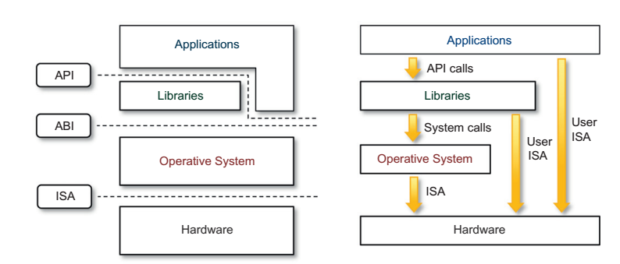
Virtualization

Slide 23
Virtualization
At the bottom layer, the model for the hardware is expressed in terms of the Instruction Set Architecture (ISA), which defines the instruction set for the processor, registers, memory, and interrupt management.
ISA is the interface between hardware and software, and it is important to the operating system (OS) developer (System ISA) and developers of applications that directly manage the underlying hardware (User ISA).
The application binary interface (ABI) separates the operating system layer from the applications and libraries, which are managed by the OS.
ABI covers details such as low-level data types, alignment, and call conventions and defines a format for executable programs.
System calls are defined at this level.

Slide 24
Virtualization
The highest level of abstraction is represented by the application programming interface (API), which interfaces applications to libraries and/or the underlying operating system.
For any operation to be performed in the application level API, ABI and ISA are responsible for making it happen. The high-level abstraction is converted into machine-level instructions to perform the actual operations supported by the processor.
This layered approach simplifies the development and implementation of computing systems and simplifies the implementation of multitasking and the coexistence of multiple executing environments.

Slide 25
Virtualization
For this purpose, the instruction set exposed by the hardware has been divided into different security classes that define who can operate with them. The first distinction can be made between privileged and nonprivileged instructions.
Nonprivileged instructions are those instructions that can be used without interfering with other tasks because they do not access shared resources.
This category examples are the floating, fixed-point, and arithmetic instructions.
Privileged instructions are those that are executed under specific restrictions and are mostly used for sensitive operations.

Slide 26
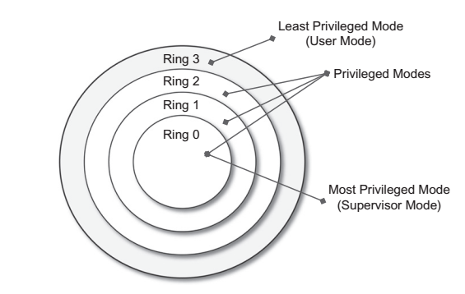
Virtualization

Slide 27
Virtualization
All the current systems support at least two different execution modes: supervisor mode and user mode.
The first mode denotes an execution mode in which all the instructions (privileged and nonprivileged) can be executed without any restriction.
This mode, also called kernel mode, is generally used by the operating system (or the hypervisor) to perform sensitive operations on hardwarelevel resources.
In user mode, there are restrictions to control the machine-level resources.
If code running in user mode invokes the privileged instructions, hardware interrupts occur and trap the potentially harmful execution of the instruction.

Slide 28
Virtualization
The distinction between user and supervisor mode allows us to understand the role of the hypervisor and why it is called that.
Conceptually, the hypervisor runs above the supervisor mode, and from here the prefix hyper- is used.
In reality, hypervisors are run in supervisor mode, and the division between privileged and nonprivileged instructions has posed challenges in designing virtual machine managers.
It is expected that all the sensitive instructions will be executed in privileged mode, which requires supervisor mode in order to avoid traps.

Slide 29
Virtualization
Without this assumption it is impossible to fully emulate and manage the status of the CPU for guest operating systems.
Unfortunately, this is not true for the original ISA, which allows 17 sensitive instructions to be called in user mode.
This prevents multiple operating systems managed by a single hypervisor to be isolated from each other, since they are able to access the privileged state of the processor and change it.
More recent implementations of ISA (Intel VT and AMD Pacifica) have solved this problem by redesigning such instructions as privileged ones.

Slide 30
Hardware-level Virtualization
Hardware-level virtualization is a virtualization technique that provides an abstract execution environment in terms of computer hardware on top of which a guest operating system can be run.
In this model, the guest is represented by the operating system, the host by the physical computer hardware, the virtual machine by its emulation, and the virtual machine manager by the hypervisor.
Hardware-level virtualization is also called system virtualization, since it provides ISA to virtual machines, which is the representation of the hardware interface of a system.
This is to differentiate it from process virtual machines, which expose ABI to virtual machines.

Slide 31
Hardware-level Virtualization
A fundamental element of hardware virtualization is the hypervisor, or virtual machine manager (VMM).
It recreates a hardware environment in which guest operating systems are installed.
There are two major types of hypervisor: Type I and Type II
Type I hypervisors run directly on top of the hardware.
Therefore, they take the place of the operating systems and interact directly with the ISA interface exposed by the underlying hardware, and they emulate this interface in order to allow the management of guest operating systems.
This type of hypervisor is also called a native virtual machine since it runs natively on hardware.

Slide 32
Hardware-level Virtualization
Type II hypervisors require the support of an operating system to provide virtualization services.
This means that they are programs managed by the operating system, which interact with it through the ABI and emulate the ISA of virtual hardware for guest operating systems.
This type of hypervisor is also called a hosted virtual machine since it is hosted within an operating system.

Slide 33
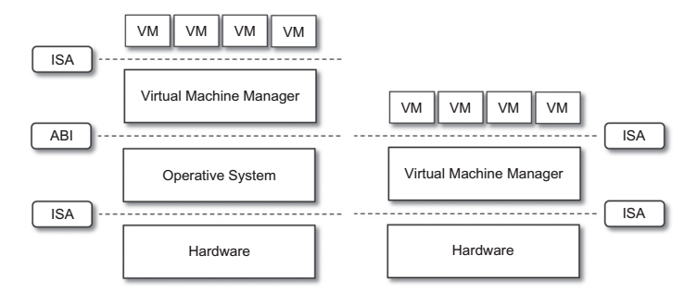
Hardware-level Virtualization

Slide 34
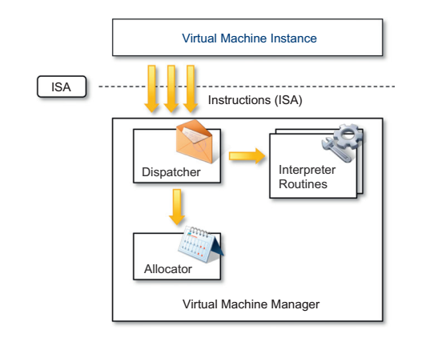
Virtualization

Slide 35
Virtualization
Conceptually, a virtual machine manager is internally organized into three main modules, dispatcher, allocator, and interpreter, coordinate their activity in order to emulate the underlying hardware.
The dispatcher constitutes the entry point of the monitor and reroutes the instructions issued by the virtual machine instance to one of the two other modules.
The allocator is responsible for deciding the system resources to be provided to the VM: whenever a virtual machine tries to execute an instruction that results in changing the machine resources associated with that VM, the allocator is invoked by the dispatcher.
The interpreter module consists of interpreter routines.
These are executed whenever a virtual machine executes a privileged instruction: a trap is triggered and the corresponding routine is executed.

Slide 36
Virtualization
The design and architecture of a virtual machine manager, together with the underlying hardware design of the host machine, determine the full realization of hardware virtualization, where a guest operating system can be transparently executed on top of a VMM as though it were run on the underlying hardware.
The criteria that need to be met by a virtual machine manager to efficiently support virtualization were established by Goldberg and Popek in 1974.
Three properties have to be satisfied:
Equivalence - A guest running under the control of a virtual machine manager should exhibit the same behavior as when it is executed directly on the physical host.
Resource control - The virtual machine manager should be in complete control of virtualized resources.

Slide 37
Virtualization
Efficiency - A statistically dominant fraction of the machine instructions should be executed without intervention from the virtual machine manager.
The major factor that determines whether these properties are satisfied is represented by the layout of the ISA of the host running a virtual machine manager.
Popek and Goldberg provided a classification of the instruction set and proposed three theorems that define the properties that hardware instructions need to satisfy in order to efficiently support virtualization.

Slide 38
Virtualization
This theorem establishes that all the instructions that change the configuration of the system resources should generate a trap in user mode and be executed under the control of the virtual machine manager.
This allows hypervisors to efficiently control only those instructions that would reveal the presence of an abstraction layer while executing all the rest of the instructions without considerable performance loss.
The theorem always guarantees the resource control property when the hypervisor is in the most privileged mode (Ring 0).
The nonprivileged instructions must be executed without the intervention of the hypervisor. The equivalence property also holds good since the output of the code is the same in both cases because the code is not changed.

Slide 39
Virtualization
Recursive virtualization is the ability to run a virtual machine manager on top of another virtual machine manager.
This allows nesting hypervisors as long as the capacity of the underlying resources can accommodate that.
Virtualizable hardware is a prerequisite to recursive virtualization.
There is another term, hybrid virtual machine (HVM), which is less efficient than the virtual machine system.
In the case of an HVM, more instructions are interpreted rather than being executed directly.
All instructions in virtual supervisor mode are interpreted. Whenever there is an attempt to execute a behavior-sensitive or control-sensitive instruction, HVM controls the execution directly or gains the control via a trap.
Here all sensitive instructions are caught by HVM that are simulated.

Slide 40
Hardware virtualization techniques
Hardware-assisted virtualization.
This term refers to a scenario in which the hardware provides architectural support for building a virtual machine manager able to run a guest operating system in complete isolation.
This technique was originally introduced in the IBM System/370.
At present, examples of hardware-assisted virtualization are the extensions to the x86-64 bit architecture introduced with Intel VT (formerly known as Vanderpool) and AMD V (formerly known as Pacifica).

Slide 41
Hardware virtualization techniques
These extensions, which differ between the two vendors, are meant to reduce the performance penalties experienced by emulating x86 hardware with hypervisors.
Before the introduction of hardware-assisted virtualization, software emulation of x86 hardware was significantly costly from the performance point of view.
The reason for this is that by design the x86 architecture did not meet the formal requirements introduced by Popek and Goldberg, and early products were using binary translation to trap some sensitive instructions and provide an emulated version.

Slide 42
Hardware virtualization techniques
Full virtualization.
Full virtualization refers to the ability to run a program, most likely an operating system, directly on top of a virtual machine and without any modification, as though it were run on the raw hardware.
To make this possible, virtual machine managers are required to provide a complete emulation of the entire underlying hardware.
The principal advantage of full virtualization is complete isolation, which leads to enhanced security, ease of emulation of different architectures, and coexistence of different systems on the same platform.

Slide 43
Hardware virtualization techniques
full virtualization poses important concerns related to performance and technical implementation.
A key challenge is the interception of privileged instructions such as I/O instructions: Since they change the state of the resources exposed by the host, they have to be contained within the virtual machine manager.
A simple solution to achieve full virtualization is to provide a virtual environment for all the instructions, thus posing some limits on performance.
A successful and efficient implementation of full virtualization is obtained with a combination of hardware and software, not allowing potentially harmful instructions to be executed directly on the host.
This is what is accomplished through hardware-assisted virtualization.

Slide 44
Hardware virtualization techniques
Paravirtualization.
This is a not-transparent virtualization solution that allows implementing thin virtual machine managers.
Paravirtualization techniques expose a software interface to the virtual machine that is slightly modified from the host and, as a consequence, guests need to be modified.
The aim of paravirtualization is to provide the capability to demand the execution of performance-critical operations directly on the host, thus preventing performance losses that would otherwise be experienced in managed execution.

Slide 45
Hardware virtualization techniques
This allows a simpler implementation of virtual machine managers that have to simply transfer the execution of these operations, which were hard to virtualize, directly to the host.
To take advantage of such an opportunity, guest operating systems need to be modified and explicitly ported by remapping the performance-critical operations through the virtual machine software interface.
This is possible when the source code of the operating system is available, and this is the reason that paravirtualization was mostly explored in the opensource and academic environment.

Slide 46
Hardware virtualization techniques
Partial virtualization.
Partial virtualization provides a partial emulation of the underlying hardware, thus not allowing the complete execution of the guest operating system in complete isolation.
Partial virtualization allows many applications to run transparently, but not all the features of the operating system can be supported, as happens with full virtualization.
An example of partial virtualization is address space virtualization used in time-sharing systems; this allows multiple applications and users to run concurrently in a separate memory space, but they still share the same hardware resources (disk, processor, and network).

Slide 47
Operating system-level virtualization
Operating system-level virtualization offers the opportunity to create different and separated execution environments for applications that are managed concurrently.
Differently from hardware virtualization, there is no virtual machine manager or hypervisor, and the virtualization is done within a single operating system, where the OS kernel allows for multiple isolated user space instances.
The kernel is also responsible for sharing the system resources among instances and for limiting the impact of instances on each other.
A user space instance in general contains a proper view of the file system, which is completely isolated, and separate IP addresses, software configurations, and access to devices.
Operating systems supporting this type of virtualization are general-purpose, timeshared operating systems with the capability to provide stronger namespace and resource isolation.

Slide 48
Virtualization
Examples of operating system-level virtualizations are FreeBSD Jails, IBM Logical Partition (LPAR), SolarisZones and Containers, Parallels Virtuozzo Containers, OpenVZ, iCore Virtual Accounts, Free Virtual Private Server (FreeVPS), and others.
Programming language-level virtualization
Programming language-level virtualization is mostly used to achieve ease of deployment of applications, managed execution, and portability across different platforms and operating systems.
It consists of a virtual machine executing the byte code of a program, which is the result of the compilation process.
Compilers implemented and used this technology to produce a binary format representing the machine code for an abstract architecture.
At runtime, the byte code can be either interpreted or compiled on the fly/or jitted against the underlying hardware instruction set.

Slide 49
Virtualization
The main advantage of programming-level virtual machines, also called process virtual machines, is the ability to provide a uniform execution environment across different platforms.
Programs compiled into byte code can be executed on any operating system and platform for which a virtual machine able to execute that code has been provided.
From a development lifecycle point of view, this simplifies the development and deployment efforts since it is not necessary to provide different versions of the same code.

Slide 50
Application-level virtualization
Application-level virtualization is a technique allowing applications to be run in runtime environments that do not natively support all the features required by such applications.
In this scenario, applications are not installed in the expected runtime environment but are run as though they were.
In general, these techniques are mostly concerned with partial file systems, libraries, and operating system component emulation.
Such emulation is performed by a thin layer—a program or an operating system component—that is in charge of executing the application.

Slide 51
Application-level virtualization
Application virtualization is a good solution in the case of missing libraries in the host operating system; in this case a replacement library can be linked with the application, or library calls can be remapped to existing functions available in the host system.
Compared to programming-level virtualization, which works across all the applications developed for that virtual machine, application-level virtualization works for a specific environment.
It supports all the applications that run on top of a specific environment.

Slide 52
Storage virtualization
Storage virtualization is a system administration practice that allows decoupling the physical organization of the hardware from its logical representation.
Using this technique, users do not have to be worried about the specific location of their data, which can be identified using a logical path.
There are different techniques for storage virtualization.
Windows dynamic disks and LVM Linux are some of the examples.
SANs use a network-accessible device through a large bandwidth connection to provide storage facilities.

Slide 53
Network virtualization
Network virtualization combines hardware appliances and specific software for the creation and management of a virtual network.
Network virtualization can aggregate different physical devices into a single logical network (external network virtualization) or provide network-like functionality to an operating system partition (internal network virtualization).
The result of external network virtualization is generally a virtual LAN (VLAN).
A VLAN is an aggregation of hosts that communicate with each other as though they were located under the same broadcasting domain.

Slide 54
Network virtualization
Internal network virtualization is generally applied together with hardware and operating system-level virtualization.
In this the guests obtain a virtual network interface to communicate with.
There are several options for implementing internal network virtualization.
The guest can share the same network interface of the host and use Network Address Translation (NAT) to access the network or can work in bridged mode.

Slide 55
Desktop virtualization
Desktop virtualization abstracts the desktop environment available on a personal computer in order to provide access to it using a client/server approach.
Similarly to hardware virtualization, desktop virtualization makes accessible a different system as though it were natively installed on the host, but this system is remotely stored on a different host and accessed through a network connection.
Desktop virtualization addresses the problem of making the same desktop environment accessible from everywhere.
The advantages of desktop virtualization are high availability, persistence, accessibility, and ease of management.

Slide 56
Virtualization
The basic services for remotely accessing a desktop environment are implemented in software components such as Windows Remote Services, VNC, and X Server.
Application server virtualization
Application server virtualization abstracts a collection of application servers that provide the same services as a single virtual application server by using load-balancing strategies and providing a high-availability infrastructure for the services hosted in the application server.

Slide 57
Virtualization - Disadvantages
Performance degradation
Performance is definitely one of the major concerns in using virtualization technology. Since virtualization interposes an abstraction layer between the guest and the host, the guest can experience increased latencies.
Hardware virtualization is realized through a program that is installed or executed on top of the host operating systems, a major source of performance degradation is represented by the fact that the virtual machine manager is executed and scheduled together with other applications, thus sharing with them the resources of the host.
Binary translation and interpretation can slow down the execution of managed applications in case of programme level virtualization.

Slide 58
Virtualization - Disadvantages
Inefficiency and degraded user experience
Virtualization can sometime lead to an inefficient use of the host. In particular, some of the specific features of the host cannot be exposed by the abstraction layer and then become inaccessible.
In the case of hardware virtualization, this could happen for device drivers.
The virtual machine can sometime simply provide a default graphic card that maps only a subset of the features available in the host.

Slide 59
Virtualization - Disadvantages
Security holes and new threats
In the case of hardware virtualization, malicious programs can preload themselves before the operating system and act as a thin virtual machine manager toward it.
The operating system is then controlled and can be manipulated to extract sensitive information of interest to third parties.
Examples of these kinds of malware are BluePill and SubVirt. BluePill, malware targeting the AMD processor family, moves the execution of the installed OS within a virtual machine.

Slide 60
Questions???

Slide 61
THANK YOU

